Slide 1
An Analysis of Traffic Accidents in Denver
John Phillips

Slide 2
Project Overview
Motivation: This analysis attempts to uncover trends and patterns among traffic accidents in the Denver Metro area over the last 10 years.
Agenda: attempt to understand general accident behavior by asking these questions
Where are the accidents usually?
Which locations are the most dangerous?
How do the accidents look over time?
What is the common cause for these accidents?

Slide 3
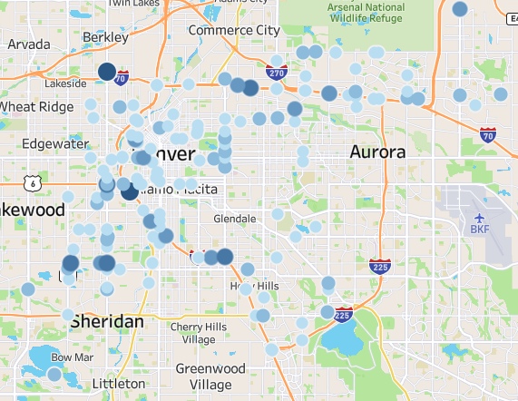
Looking for accident hotspots
This map utilized the “Fatality-Injury Index” (or FII) to illustrate the areas with the worst accidents.
The index is simply the sum of all fatalities and serious injuries from accidents; this map shows all accidents with an FII of at least 3.
The more serious the accident, the bigger and darker the blue dot is.
As you can see, and perhaps unsurprisingly, a lot of the worst accidents are located on or near major highways (I70, I25, or HWY 6).
Highway driving= faster speeds= faster collisions= higher possibility for serious injury or death.

Slide 4
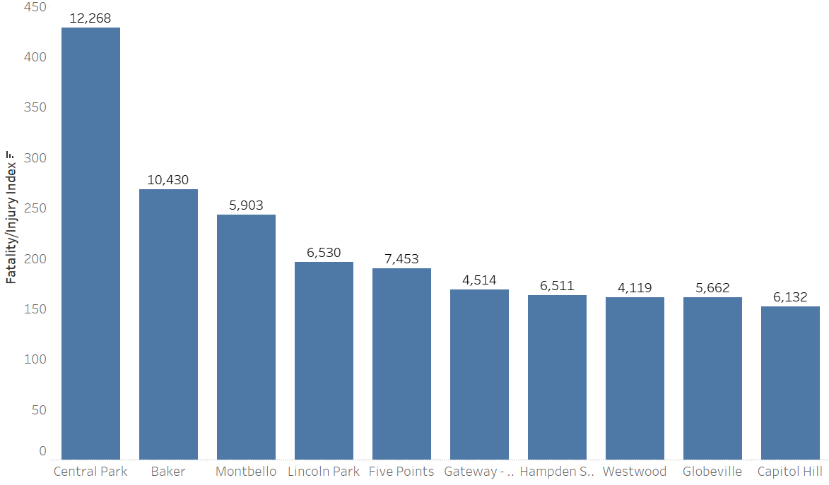
Top 10 Most Dangerous Neighborhoods
This shows the 10 most dangerous neighborhoods by their Fatality-Injury Index- a summation of the two from all accidents.
Additionally, the labels show the total count of accidents in those neighborhoods.
Central Park has both the most accidents and the highest number of fatalities and serious injuries

Slide 5
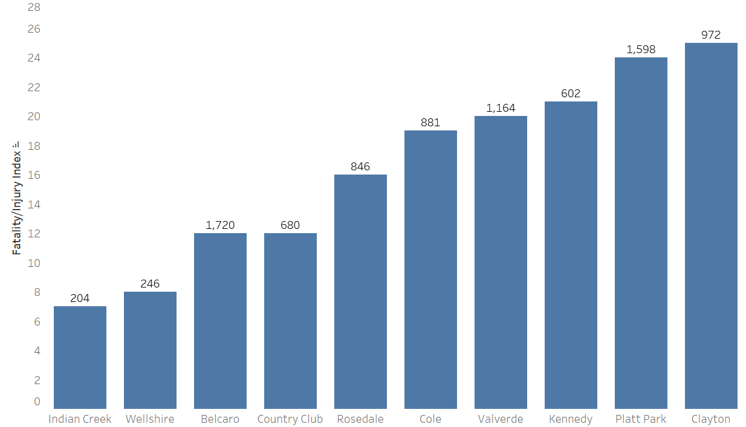
Top 10 Safest Neighborhoods
Conversely, here are the 10 safest neighborhoods.
While accidents still occur, their severity is much lower- perhaps an indication of the walkability of these areas, or some other factors.
Indian Creek has the lowest frequency of accidents and the lowest severity when they occur.

Slide 6
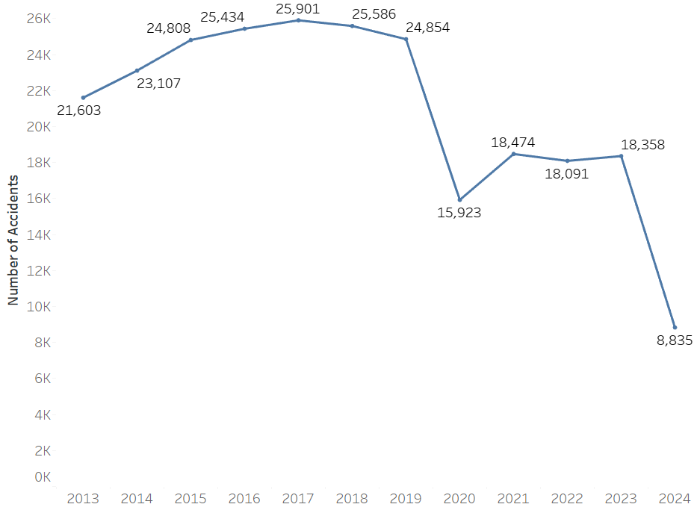
Time analysis of Denver accidents
This shows the total number of accidents per year in Denver.
As you can see, there is a big drop-off from 2019 to 2020. This can be attributed to the COVID-19 pandemic and the lockdown that ensued.
Since COVID, the numbers have remained down, despite society returning to normal.
This is most likely attributed to the rise in remote and hybrid work, leading to fewer drivers on the road, per day, on average.

Slide 7
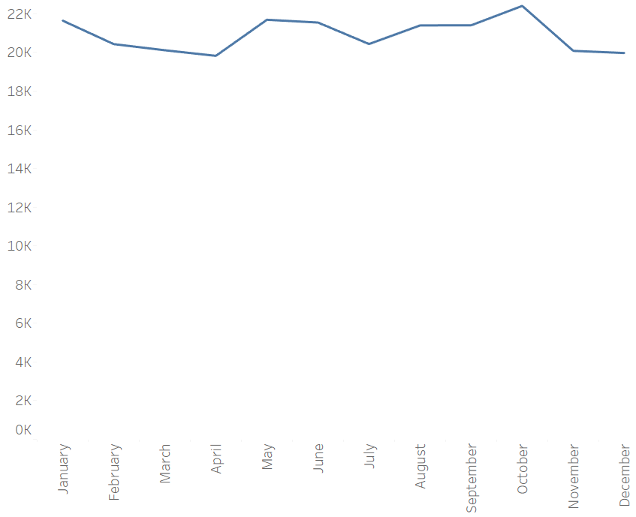
Does the time of year matter?
As the graph to the left indicates, there are relatively small variations month to month regarding accident volume.
However, the top 3 months with the most accidents are January, May, and October.
On the other hand, the 3 months with the least number of accidents are April, November, and December.

Slide 8
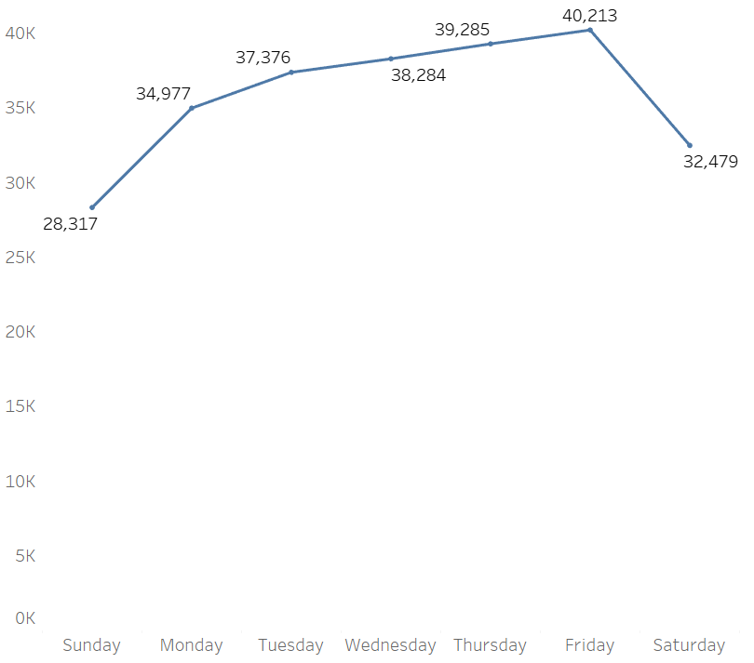
What about day of the week?
Saturday and Sunday are the two safest days for driving.
This is most likely due to significantly less commute drivers on the road.
Friday is the most dangerous day- this could be due to the typical “weekend rush” of people who are trying to get to the mountains or out of the city.
This, in combination with normal commute drivers, likely explains the higher incidence of accidents.

Slide 9
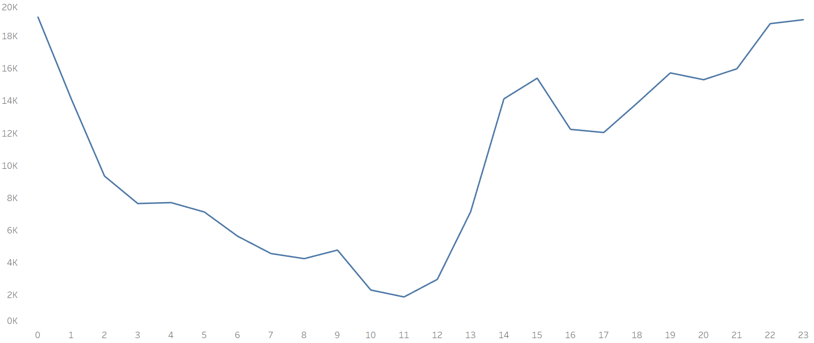
When is the safest time of day to drive?
This graph shows the hours of the day (x-axis) and the number of accidents (y-axis). The hours between 10:00 a.m. and noon are the safest for driving- this probably coincides with the fewest drivers on the road.
Conversely, the hours between 10:00 p.m. and midnight are the most dangerous for driving- this can be attributed to the dark hours of night, and an increased number of drivers on the road who are under the influence.

Slide 10
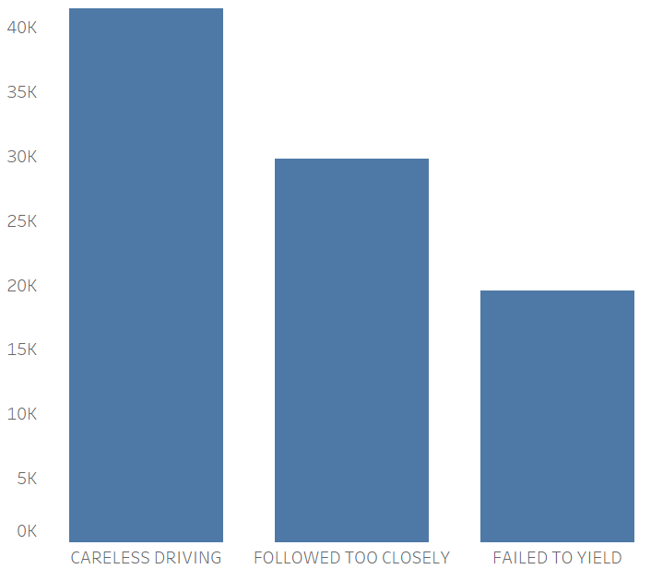
Why do accidents happen?
This shows the 3 most common reasons for accidents: careless driving, following too closely, and failing to yield.
This serves as a reminder to remain diligent on the roads.
It only takes one moment of reduced focus for an accident to happen.

Slide 11
How is this analysis useful?
From 2013 to 2023, on average, there were 22,013 accidents per year.
That comes out to 60 car accidents per day; almost 3 per hour.
With frequent accidents, it is wise to know the safest times, conditions and locations for driving.
This analysis helps us understand when it is safest to be on the roads.
The next slide will detail my Denver driving recommendations.

Slide 12
Denver Driving Recommendations
Based on my analysis, these conditions provide the safest parameters for driving:
Time of day: between 10:00 am and 12:00 pm
Day of week: Saturday or Sunday
Type of roadway: local streets or neighborhoods
Colorado Blvd, Federal Blvd, Colfax Ave should be avoided
Road conditions: dry; avoid ice, snow, rain

Slide 13
Main Data Sources
Denver Open Data Catalog
Run by the city and county of Denver, it is a public access website for various data sets involving transportation, public safety, education, etc.
First published in 2020, last updated June 2024

Slide 14
Questions?

